Slide 1
Welcome to My Presentation

Slide 2
Name : Sheikh Sabit islam
Batch : 039
Department : Management studies
Date : 01/12/24

Slide 3

“Feel better, look great, and get more out of life”.

Slide 4



Our Different Product Segment
Personal Care
Ice-Cream
Home Care

Slide 5

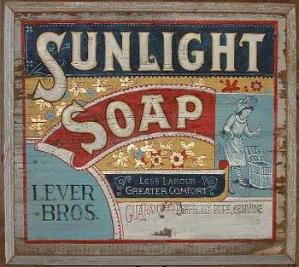
Introduction
Legal Structure & Governance
Unilever was formed in 1930 from two companies: Margarine unie & lever brothers.
It was a full business merger,
Operating as single business entity.
Margarine Unie
(Netherlands)
Two separate legal parent companies have been maintained :
Unilever NV (Netherlands)
& Unilever PLC (UK)
This Work Through An equalization Agreement and other contracts between the two companies
Lever Brothers
(United Kingdom)

Slide 6
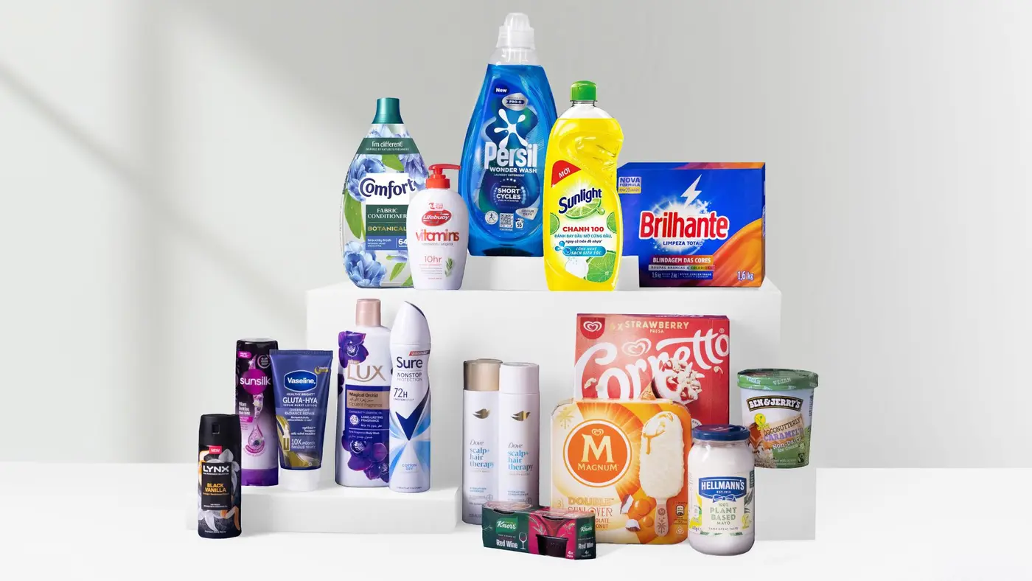
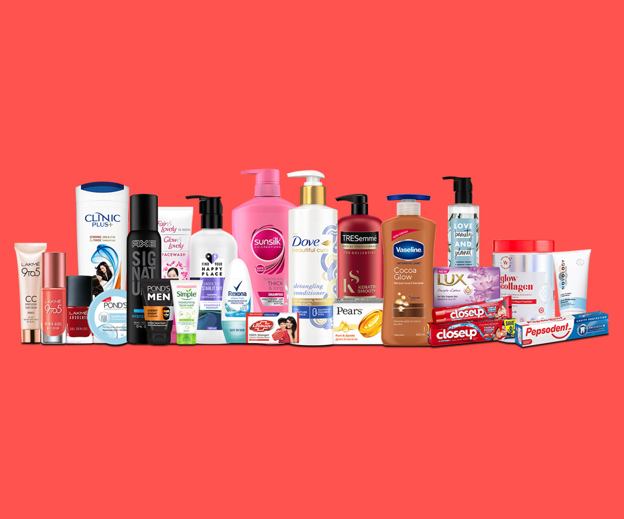
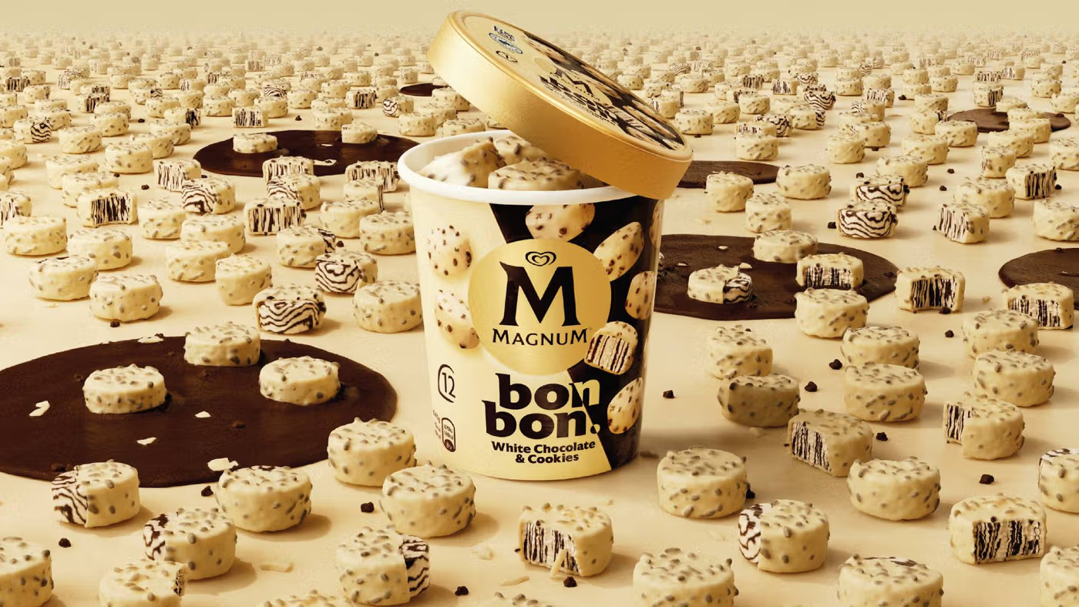
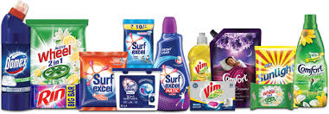
Product and services
Unilever

Slide 7
Beauty & Personal Care
Popular Brands:
Dove, Lux, Rexona, Sunsilk, Pond's, Vaseline.
Products:
Skincare, haircare, deodorants, and oral care.

Slide 8
Foods & Refreshments
Popular Brands:
Knorr, Lipton, Magnum, Hellmann's, Walls.
Products:
Ice creams, tea, soups, sauces, and meal kits.

Slide 9
Home Care
Popular Brands:
Surf Excel, OMO, Domestos, Comfort, Sunlight.
Products:
Detergents, fabric conditioners, and household cleaning products.

Slide 10
Unilever
Beauty and Personal Care
Food and Refreshment
Home Care

Slide 11
Unilever Data Analysis
Category | Turnover/ Billion | USG/ %
Beauty & Wellbeing | 6.5 | 7.1
Personal Care | 7 | 5.6
Nutrition | 6.7 | 3.2
Home Care | 6.3 | 3.3
Ice Cream | 4.6 | 0.6
Total | 31.1 | 19.8

Slide 13
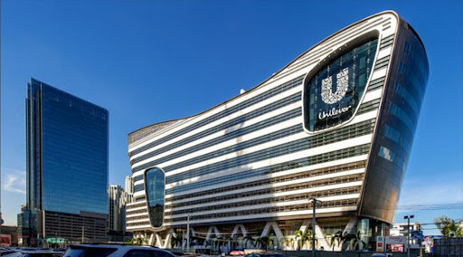
Solid Revenue Growth
Turnover & Growth
Unilever achieved a turnover of €31.1 billion in the first half of 2024, marking a 2.3% year-over-year increase. This growth highlights its ability to maintain steady market momentum.

Slide 14
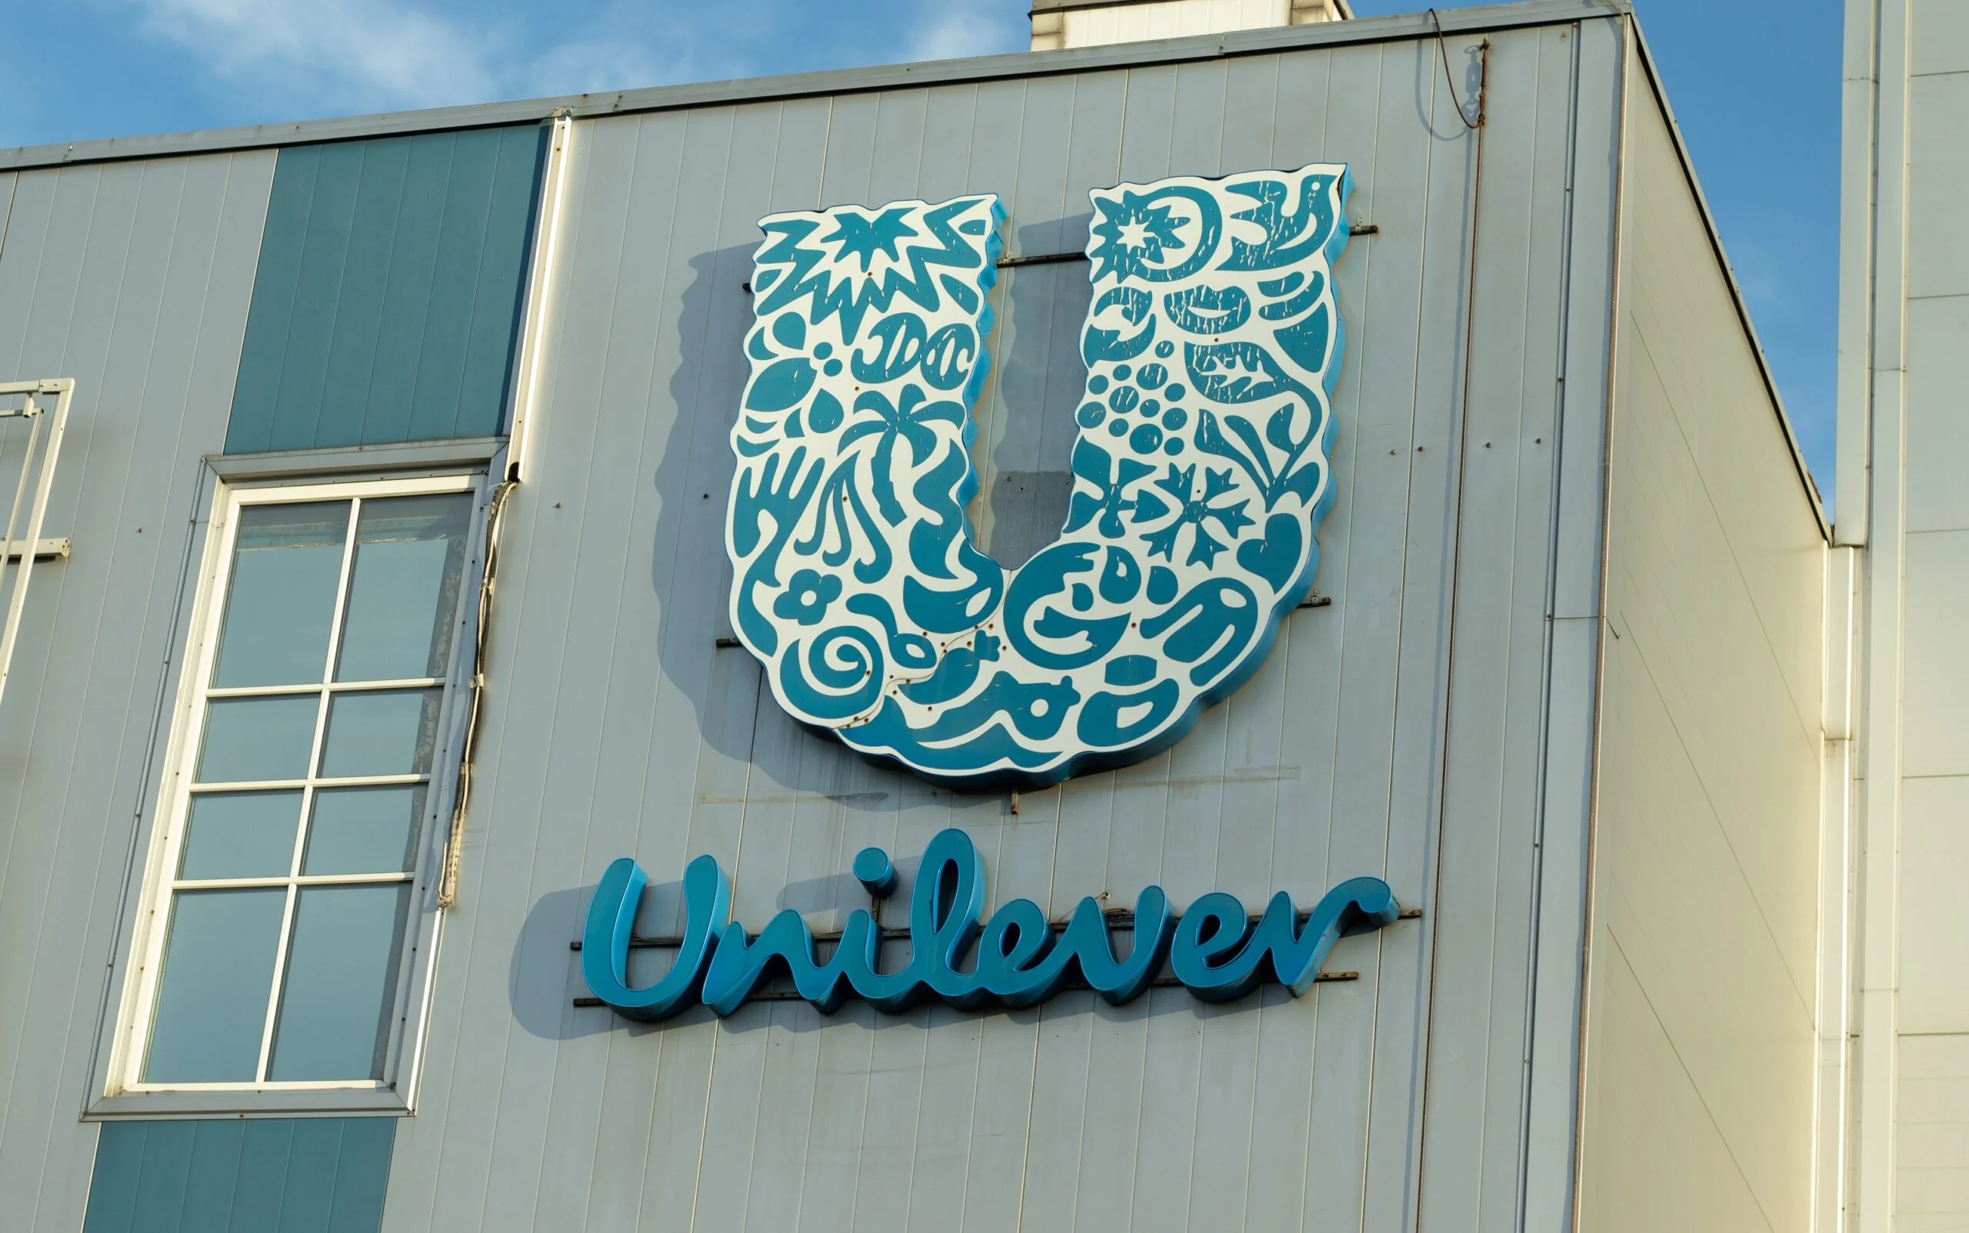
Segmental Insights
Segment & Insight
The Beauty & Wellbeing segment led growth with a turnover of €6.5 billion and a 7.1% USG.Personal Care and Nutrition segments reported strong performance, indicating Unilever’s commitment to health and personal hygiene needs.The Ice Cream segment experienced modest growth, reflecting market challenges.

Slide 15
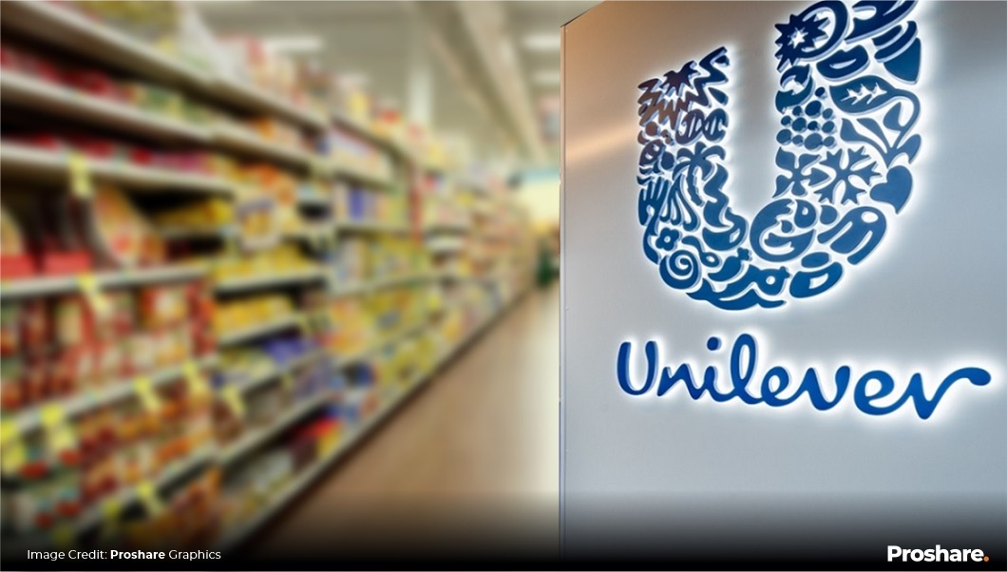
Profitability and Margins
Profit & Margins
Unilever’s underlying operating profit increased by 17.1% to €6.1 billion, demonstrating effective cost management and profitability enhancement.An improved operating margin of 19.6% reflects efficiency gains and successful premiumization strategies.

Slide 16
THANKS!

